Slide 1
Sub-set sum Problem
Arthi. D. S - 1731009
Dhaarani. S - 1731013
Keerthi Malini. S - 1731061
Sowmya Prabha. S - 1731049

Slide 2
Sub-Set Problem
Given a set of non-negative integers, and a value sum, determine if there is a subset of the given set with sum equal to given sum.
Problem :
Given an integer array A of size N.
You are also given an integer B, you need to find whether their exist a subset in A whose sum equal B.
If there exist a subset then return 1 else return 0.

Slide 3
Classical Methods to solve
Recursion.
Dynamic programming
Memoization TechniqueComplexity Analysis:
Complexity
Time Complexity: O(sum*n), where sum is the ‘target sum’ and ‘n’ is the size of array.
Auxiliary Space: O(sum*n), as the size of 2-D array is sum*n.

Slide 4
Quantum Method to solve
Variation Algorithm
The variational method in quantum theory is a classical method for finding low energy states of a quantum system.
This minimized function is then an approximation to the lowest energy eigenstate, and the expectation value serves as an upper bound on the energy of the ground state.
We are going to use a variation algorithm called Quantum Approximate Optimization Algorithm(QAOA)

Slide 5
Quantum Approximate Optimization Algorithm(QAOA)
QAOA (Quantum Approximate Optimization Algorithm) introduced by Farhi et al is a quantum algorithm that attempts to solve such combinatorial problems.
It is a variational algorithm that uses a unitary U(β,γ)U(β,γ) characterized by the parameters (β,γ)(β,γ) to prepare a quantum state |ψ(β,γ)⟩|ψ(β,γ)⟩.
The goal of the algorithm is to find optimal parameters (βopt,γopt) such that the quantum state |ψ (βopt,γopt)⟩|ψ (βopt,γopt)⟩ encodes the solution to the problem.

Slide 6

Solution
QAOA ansatz given by
Defined functions to calculate the cost at each iteration, we define a function ’qaoa’ that uses the scipy implementation of COBYLA optimiser to optimise the randomly initialised parameters β and γ for each layer of QAOA.
The number of layers has been stored in the variable p and the variable L denotes the aforementioned S

Slide 7
Solution
Where HM is the standard mixing Hamiltonian, H is the Hadamard gate, and β and γ are the parameters that need to be optimised to minimise the cost hγ, β|HC|β, γi. The ansatz can be prepared by following the steps:
n qubits are initialised to the state |0i, as usual
Hadamard gate is applied on each of them
The unitary e −iγHC is implemented as:
(a) For the i th node in the graph, applying the U1 gate on the i th qubit with the parameter si(si − 2S)γ. The nodes are stored as a list of tuples whose first element is the nodenumber, and the second element is si .
(b) For the edge between the i th and j th nodes, applying the CRZ (CU1) gate with i th as the control and j th as the target qubit, and 2sisjγ as the parameter. The edges are stored as a list of triples containing the numbers of the two vertices and the weight of the edge between them.
(c) The term e −iS2 I ⊗n is just a global phase, and can safely be ignored.
The unitary corresponding to the mixing Hamiltonian is applied as usual using the RX gate with 2β as the parameter on all the qubits.

Slide 8
Solution
Once the parameters have been optimised to minimise the cost hγ, β|HC|β, γi, the final parameters can be used to recreate the circuit from which the final state of the qubits can be measured to get our solution.
The histogram shows the relative frequency of the obtained measurements, where the least significant bit denotes the first real number of the set ξ, and the most significant bit denotes the last number of the set. For the measurement having the highest frequency, if the reading corresponding to si is 1, then it is placed into the new set ζ

Slide 9
Outputs

Slide 10
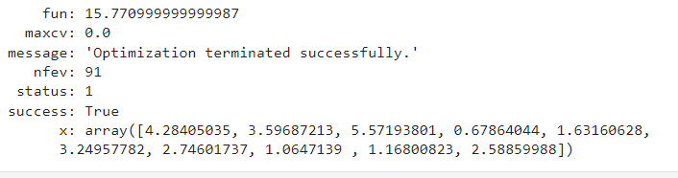
Result

Slide 11
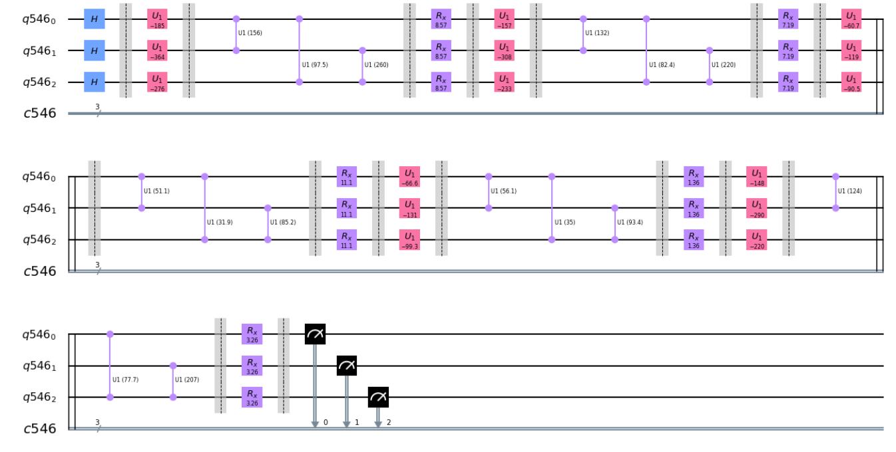
Circuits

Slide 12
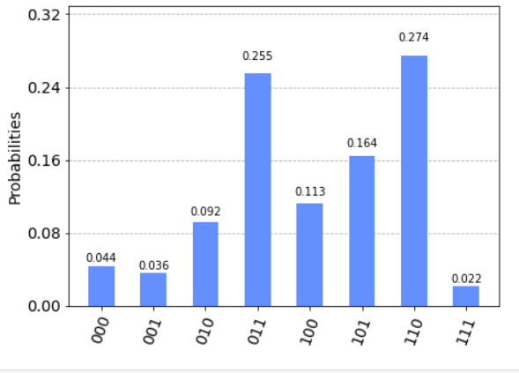
Histogram

Slide 13
Github Link
https://github.com/DhaaraniCIT/QAOA-subset-sum

Slide 14
Reference
https://qiskit.org/textbook/ch-applications/qaoa.html
Quantum Approximate Optimization Algorithm — Qiskit 0.25.4 documentation
E. Farhi, J. Goldstone, S. Gutmann, "A Quantum Approximate Optimization Algorithm"
H. Abraham, et al, "Qiskit: An Open-source Framework for Quantum Computing"

Slide 15
Thank you!!

